Slide 1

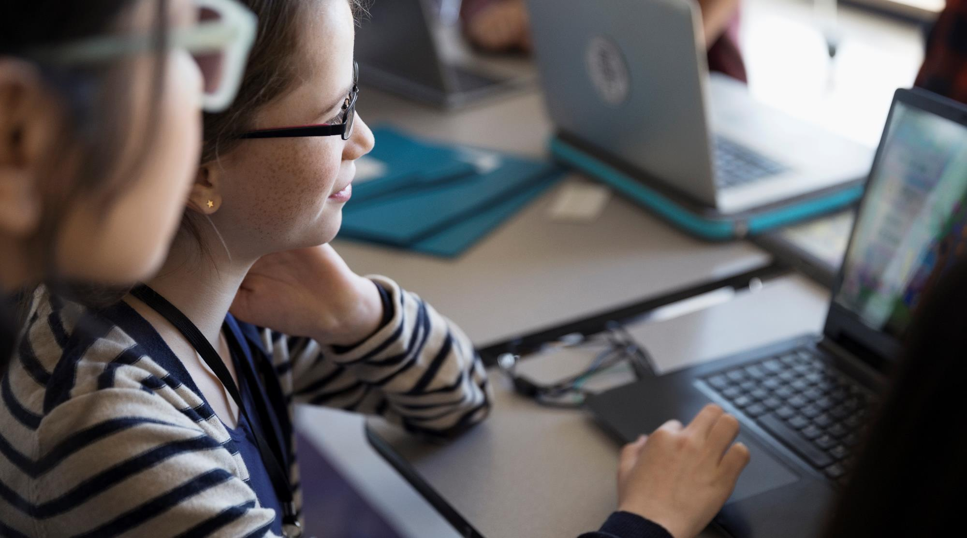
Disrupting the gaps in networking
Sharda Linkedin
A new way to engage with seniors, faculties & alumnus from across the university and beyond

Slide 2

By
Sharda Linked.in
basically will be a social media cum networking platform geared to Students of different sessions / Faculties of different departments & Alumnus. It enables you to network and to build your professional portfolio, you can also go out into the world and look for a mentor who can help you in your career.
Sharda Linked.in
Shivam Sharma

Slide 3


OUR BIG IDEA
There are nearly 5000 students studying and more than 200 faculties in sharda university . our idea is to provide them a single platform so that they can develop a professional network with other students and faculties within the university and share there productive thoughts with each other.

Slide 4



Target Audience(s)
Faculties
Students
Alumnus
Sharda University
Sharda University
Global

Slide 5



How Sharda Linked.in can help
Establish your professional profile and control one of the top search results for your name
Build and maintain your professional network within campus or globally
Find and connect with classmates, senior or faculties
Find other professionals in the same fields as you
Discover new career opportunities by interacting with professionals

Slide 6

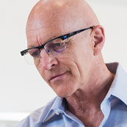



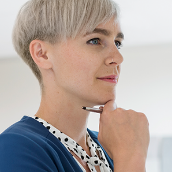

Network Chart #ConnectingProfessionals
Sharda Linkedin
Mira Nitin
Alumni
Author
A Business Expert MBA - final year Sharda University
Experience
Prof.
MIRA KARLSSON CSE – 3rd year
CSE - Expert
Sharda University
A Fresher
1st year B.Tech
Sharda University
Krishna Engineering 2nd year
Sharda University
Business Fresher
Yale
BBA 3rd year
Sharda University
Helping Hands
Needs Guidance

Slide 7





Tech Requirements
HTML | CSS | JS
PHP | Servers
MySQL | Storage
Java
Android Development
For coding the dynamic and attractive UI of the website
For developing connections with the servers or we can say dynamic webpages
For Database Manipulation
For coding of the Sharda Linkedin’s Android Application
For developing the Android Application

Slide 8
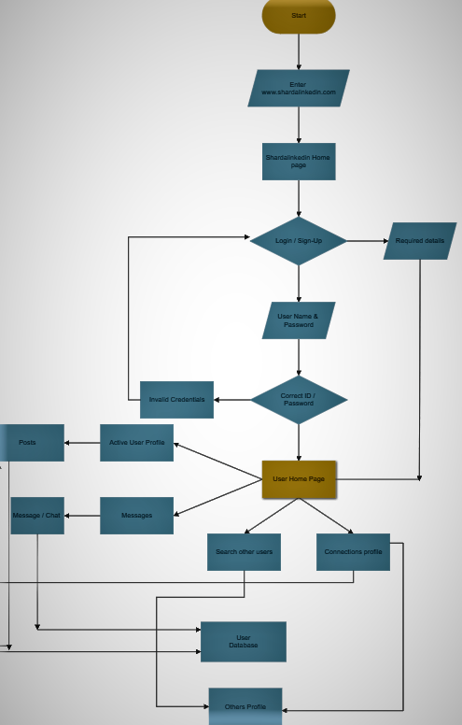
Business Model
Working / Block Diagram
There is an opportunity for success

Slide 9

Sharda Linked.In
SL.In
A new way to engage with your seniors, faculties and professionals from across the university & beyond.

